Slide 1
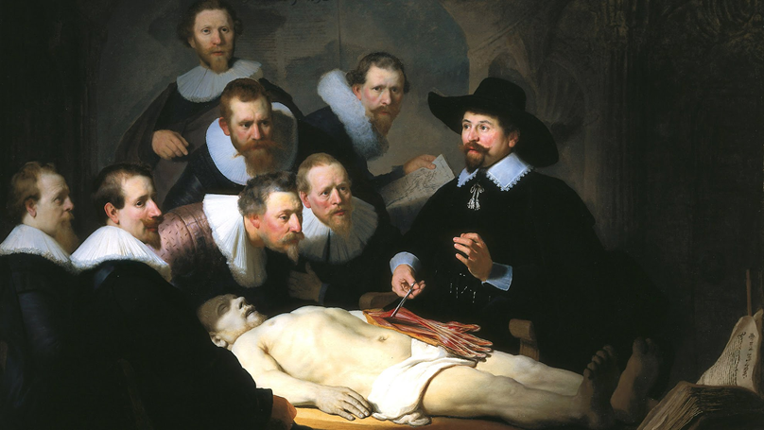
Recent changes in global medical Research ethics
Recent trends
Declaration of Helsinki principles
Examples of controversial issues
17.6.1 Explain recent changes in global medical research ethics and why
they have come about
Unit C 17.6 Trends in Medical Research Ethics
Module 279-17-C Regulations, Standards and Ethics
dr. Chris R. Mol, BME, NORTEC, 2016

Slide 2
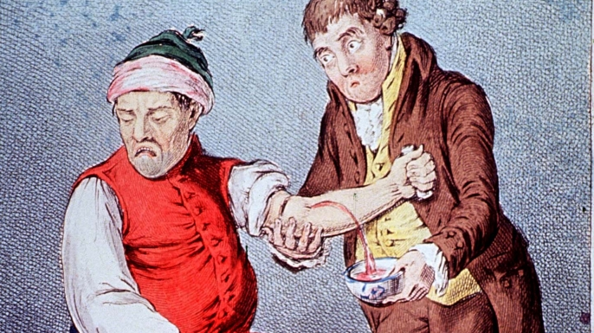
Medical Research Ethics
Throughout history, humans have been interested in finding cures for their diseases. Treatments could be herbs, traditional medicine, surgery, bloodletting, sacrifices, exorcism, spiritual procedures, etc.
Over the last few hundred years, humans have attempted to improve medical therapies by understanding the underlying physical causes of the disease and the functioning of the human body.
Using the same ‘scientific’ approach that was behind the ‘discovery’ (mapping) of the world and the ‘discovery’ of the laws of nature in physics, our understanding of Anatomy and Physiology has advanced very much through this.
This in turn has significantly advanced the development of new medical therapies.
‘Bloodletting’
‘discovery of the world’
©
Changes in Research Ethics
dr. Chris R. Mol, BME, NORTEC, 2016

Slide 3
Medical Research Ethics
A special problem with the study of the functioning of the human body is that it evokes many ethical problems.
For example:
is it ethically ok to cut open a dead human body in order to study how it functions when alive ?
Today, in Western countries, you can decide in your testament to leave your body after death to science for further study …….
Rembrandt, The Anatomy Lesson of Dr. Tulp
©
Changes in Research Ethics
dr. Chris R. Mol, BME, NORTEC, 2016

Slide 4
Medical Research Ethics
To study the function and diseases of the human body in more detail, you must not only study dead bodies, but also living ones. No matter how much basic research and animal experimentation has been conducted on a given device, the risks and benefits it poses for humans cannot be adequately determined until it is actually used on humans.
The key question that is addressed in medical research ethics is:
under what conditions is it ethically ok to do certain types of research experiments on humans?
The answer to this question became especially urgent after some clearly unethical practices took place:
World War II German ‘medical experiments’ on Jews, Gypsies and Slavic people
World War II Japanese ‘medical experiments’ on Chinese prisoners of war in Manchuria
US Tuskegee Syphilis study, a 1932-1972 ‘study in nature’ of untreated syphilis in 412 African American men (see next slide).
and others…..
Tomorrow’s medicine is today’s research
©
Changes in Research Ethics
dr. Chris R. Mol, BME, NORTEC, 2016

Slide 5
The Tuskegee Syphilis study
Syphilis is a sexually transmitted, bacterial infection, currently treated with antibiotics
1932 USA research aimed at determining the natural course of untreated, latent syphilis in black males and the possibilities for mass treatment under the belief that antisyphilitic tx (a pharmaceutical drug) was unnecessary. The town of Tuskegee was found to have the highest rate of syphilis.
The subjects were syphilitic black males between 26-60 yrs. There was no intention of providing any treatment. They were told they were ill and were promised free care. The subjects were not told they were participating in an experiment. 400 syphilitic males, as well as 200 uninfected controls. Most of the men were given either non-effective therapy or inadequate doses. The 1st published report came in 1936. the whole experiment was scheduled for at least 6/12 years.
When penicillin was invented and became widely available around 1945, the men did not receive this. In 1969, a committee decided that the study should be continued. Only in 1972 did the department of health, education, and welfare halt the experiment.
In 1972, an investigatory panel was established which issued a report the following year and found that the study had been “ethically unjustified” and argued that penicillin should have been provided to the men.
74 of the test subjects were still alive; more than 100 had died directly from advanced syphilitic.
©
Changes in Research Ethics
dr. Chris R. Mol, BME, NORTEC, 2016

Slide 6
Nuremberg Code
Shocked by what took place in the WWII concentration camps, the world community in 1949 joined to sign a code for proper research ethics, known as the Nuremberg Code. (Nuremberg is a city in Germany.)
The core of this code is that unless an individual voluntarily consents to participate in a medical experiment, he or she may not be used as a research subject. Proper voluntary consent requires:
the capacity to consent
freedom from coercion
comprehension of the risk and benefits of the research
The Code also states that researchers have to show that their experiments
offered a favourable risk-benefit ratio to their subjects
were properly designed
permitted subjects to withdraw at any time.
And: prisoners, children and patients in mental hospital should not be used as research subjects.
©
Changes in Research Ethics
dr. Chris R. Mol, BME, NORTEC, 2016

Slide 7
Declaration of Helsinki principles
In 1964, the Nuremberg code was updated to the Helsinki Declaration. It has been updated several times since then. The Declaration governs international research ethics related to experiments on humans.
The Declaration deals with four main issues:
respect for the autonomy of the participants in the research, e.g.
Informed consent from research participants is necessary including Information, comprehension, and voluntary participation.
the risk of harm, e.g.
Risks should be minimal and not exceed benefits.
The interest of the research subject should always be given greater weight than those of society.
Research should maximize possible benefits and minimize possible risks.
the value and quality of the research, e.g.
Research protocols should be reviewed by an independent committee prior to initiation.
Research should be conducted by medically/scientifically qualified individuals.
aspects of justice, e.g.
The benefits and risks of research must be distributed fairly.
©
Changes in Research Ethics
dr. Chris R. Mol, BME, NORTEC, 2016

Slide 8
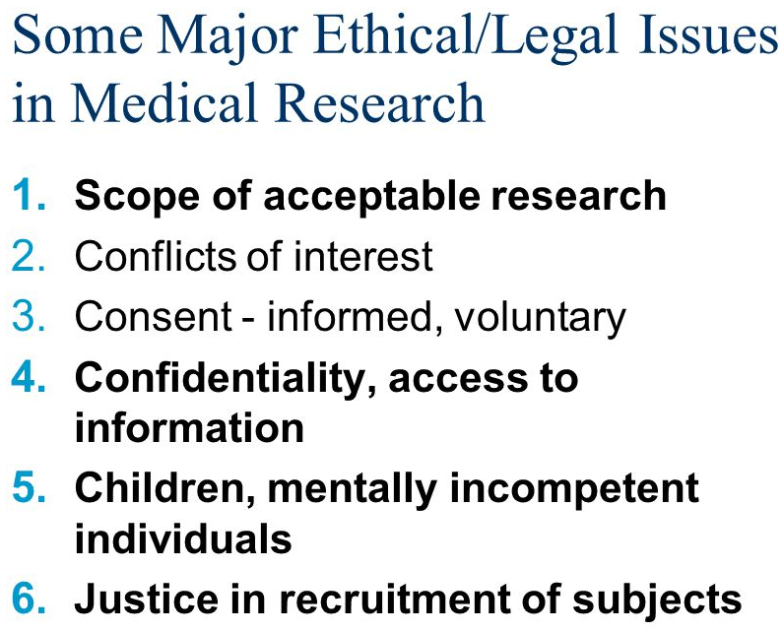
Unresolved Ethical Issues in Medical Research
Not all aspects of research ethics enjoy general agreement. As medical science continues to advance, in areas such as genetics, the neuro-sciences and organ and tissue transplantation, new questions arise regarding the ethical acceptability of techniques, procedures and treatments for which there are no ready-made answers.
In the coming slides, some of these issues will be discussed. Many of these will require a lot of further analysis and discussion before general agreement is achieved.
In the last lecture in this Ethics series, we will discuss ethics related to genetic manipulation and implants.
©
Changes in Research Ethics
dr. Chris R. Mol, BME, NORTEC, 2016

Slide 9
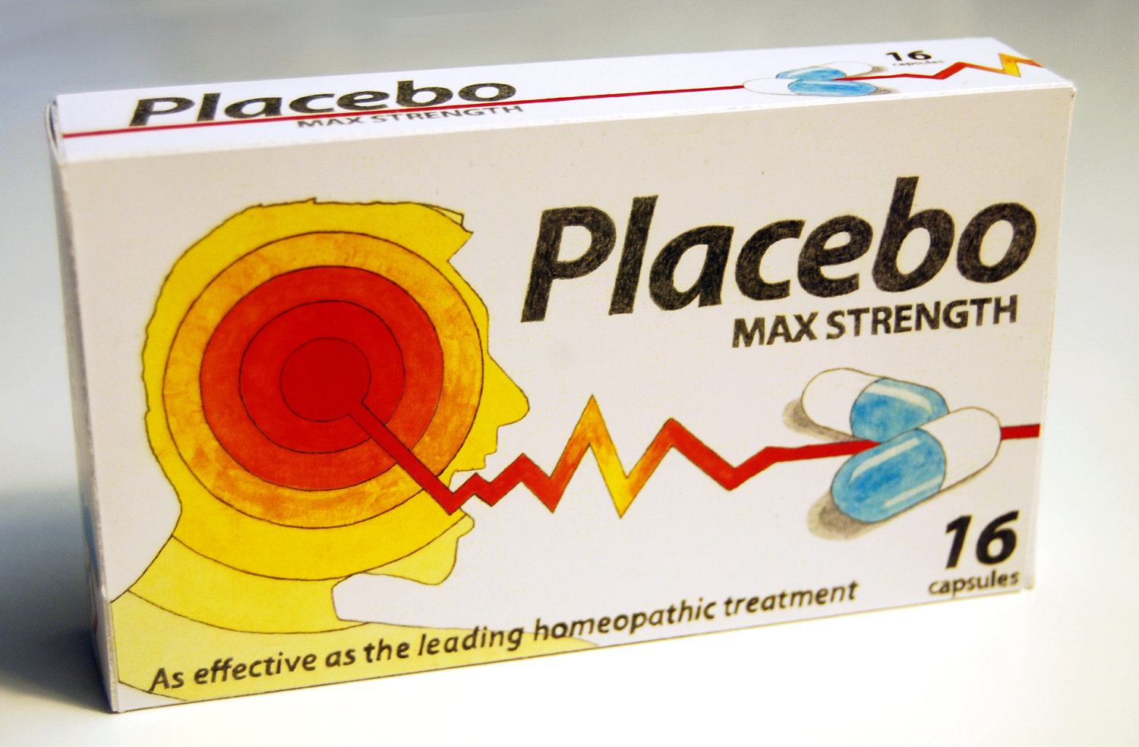
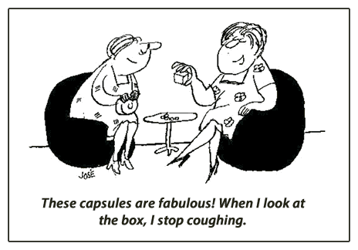
Use of Placebo medicine in clinical research
Declaration of Helsinki: “In any medical study, every patient - including those of a control group, if any -should be assured of the best proven diagnostic and therapeutic method”
In Placebo-controlled research one group of patients get the treatment/drug under research, another group gets a placebo: an ineffective treatment. The outcomes of the groups are compared to evaluate effectivity.
Is that in line with the Declaration or should the control group receive the current best treatment?
From a scientific point of view, sometimes no good alternatives over placebo control groups exists…….
Under certain conditions (i.e. inform the patients that there is a chance that they will be in the placebo/control group) placebo controlled research is often approved…..
©
Changes in Research Ethics
dr. Chris R. Mol, BME, NORTEC, 2016

Slide 10
Fairness on a global scale (?)
At a global level, the 10/90 gap in medical research (only 10% of global research funding is spent on health problems that affect 90% of the world’s population) is clearly an unresolved ethical issue.
Money continues to play an important role
©
Changes in Research Ethics
dr. Chris R. Mol, BME, NORTEC, 2016

Slide 11
Care for study Participants
What to do if clinical research of a new treatment demonstrates that the treatment is effective and study participants cannot themselves afford the treatment/drug. Will treatment simply be stopped at the end of the research or is there an obligation to continue giving the treatment to the participants of the study? And if so, who is to pay for that?
The revised Helsinki Declaration (2000) refers to the need to provide those who participated in the research with access to the interventions developed during the research.
On occasions, a participant in a study may suffer an adverse effect as a consequence of an intervention under evaluation. Clearly, during the study the researchers have a responsibility to care for those who may suffer such adverse effects arising from the research.
Such issues have to be settled before a research study in a developing country starts…
©
Changes in Research Ethics
dr. Chris R. Mol, BME, NORTEC, 2016

Slide 12
Ethical Medical Research Guidelines
In September 2000, the Indian Council on Medical Research (ICMR) published Ethical Guidelines for Biomedical Research on Human Subjects, a good example of a high-quality developing country document. The ICMR proposed that 12 general principles be considered in designing research projects involving human subjects:
essentiality (of the research);
voluntariness, informed consent, and community agreement;
non-exploitation;
privacy and confidentiality;
precaution and risk minimization;
professional competence;
accountability and transparency;
maximization of the public interest and of distributive justice;
institutional arrangements;
public domain;
totality of responsibility; and
compliance.
Research issues have to be settled before a research study in a developing country starts….
©
Ethics of clinical trials
dr. Chris R. Mol, BME, NORTEC, 2016

Slide 13
On: Ethical Clinical Research in Developing Countries see:
http://jid.oxfordjournals.org/content/189/5/930.full
END
The creation of this presentation was supported by a grant from THET:
see https://www.thet.org/

